Slide 1

Cryptool

Slide 2
Encryption & Decryption in Cryptool:
Symmetric
Asymmetric
Hybrid
Asymmetric
RSA Encryption
RSA Decryption
RSA Demonstration
Symmetric Modern
Caesar / Rot13
Vigenere
Hill
Substitution
Plafair
ADFGVX
Vernam / OTP
Homophone
Permutation
Solitaire…..
Scytale
Symmetric Classic
Caesar / Rot13
Vigenere
Hill
Substitution
Plafair
ADFGVX
Vernam / OTP
Homophone
Permutation
Solitaire…..
Scytale
Hybrid Techniques
RSA AES Encryption
RSA AES Decryption
ECC AES Encryption
ECC AES Decryption

Slide 3

Symmetric Encryption Methodology:
Steps:
Open New File. (Ctrl + N)
Write text Which you wanted to Encrypt.
After Writing Text, Go to Encrypt/Decrypt option in Menu Bar.
Now Select Encryption Type i.e. Symmetric in current case.
I wanted to do (Rinjaedal)AES CBC, So I Select This one.
After all, Select Key Length and Encrypt or Decrypt Data.
You Save to Encryption / Decryption file. (Ctrl + S)
See Gallery Slide For More.

Slide 4


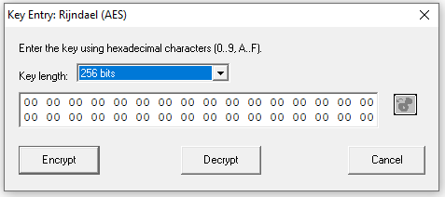
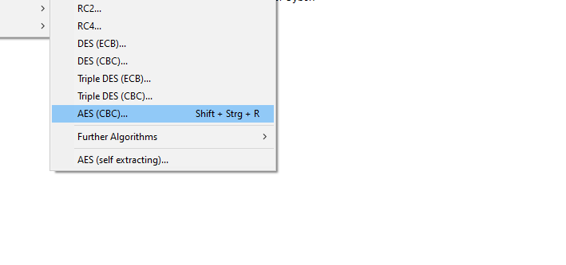
Gallery Slide
Step # 01
Step # 02
Step # 03
Step # 04

Slide 5
Digital Signatures Generation:
Steps:
Open New File. (Ctrl + N)
Write text on which you wanted to apply digital signatures.
After writing Text, Go to Digital Signatures/PKI option in Menu Bar and Select Signature Generation.
A popup menu open, Complete steps According to Flow Chart.As Describe Below.
Firstly, Select Hash Function from the list (I am Selecting SHA-1).
Then, Generate Key use Two Prime Number, After Generating Prime Numbers Apply Primes and Store Key.
After This Provide Certificate (Name, Pin, and Key Identifier), Thn Create Certificate.
After Certificate Generation,Compute Hash Value and Then Encrypt it.
After Encrypting Generate Digital Signature and Store it.
Then Save the File.

Slide 6
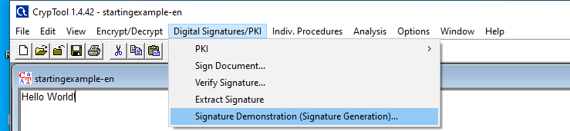
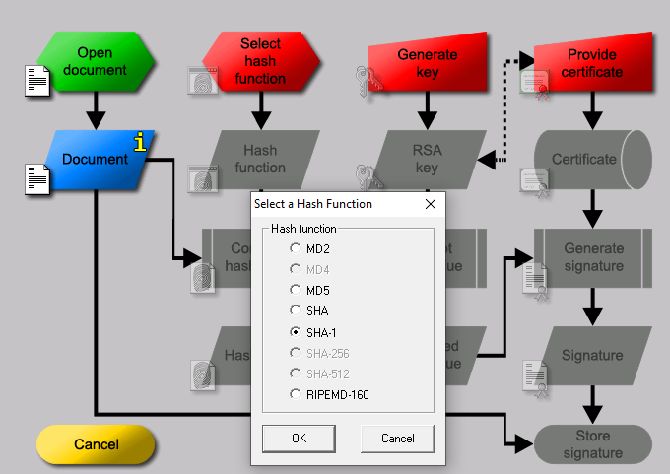
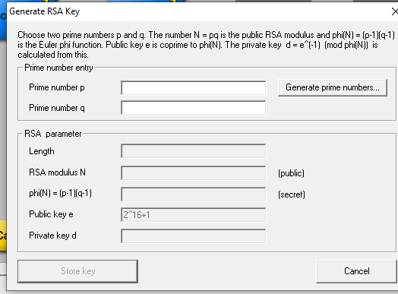
Gallery Slide For Digital Signatures:

Slide 7
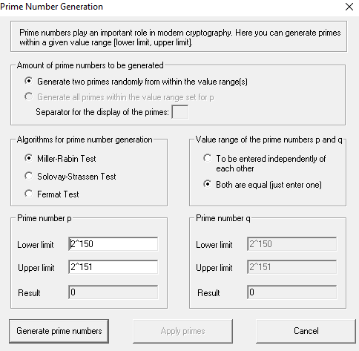
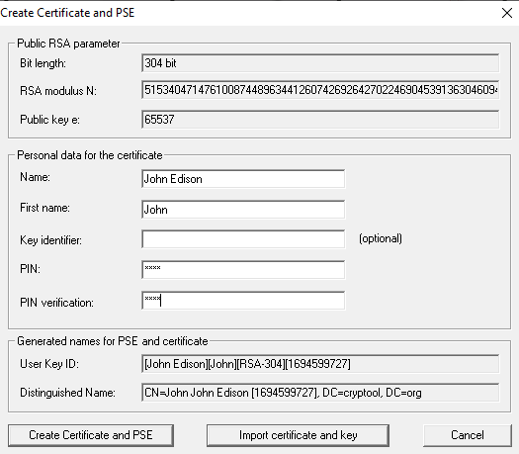
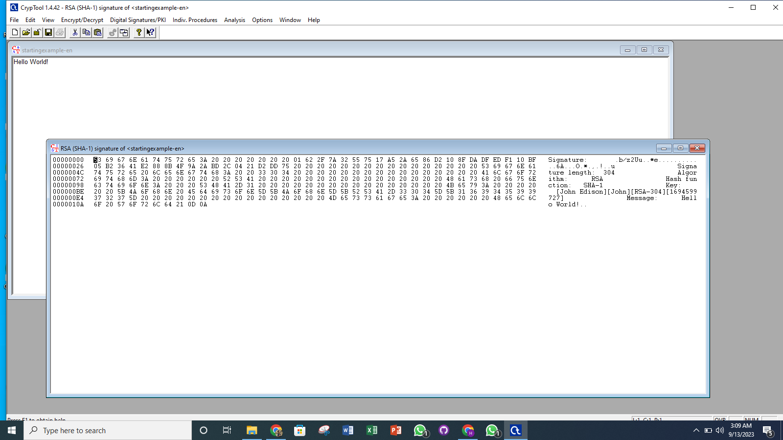
Gallery Slide For Digital Signatures:

